Slide 1


Easter Service,
March 2008.
Notes:
Easter Service – March 2008.
Introduction & Opening Prayer by Teacher.
Stations of the Cross: Reader #1
Stations of the Cross: Reader #2
Prayers of the Faithful: Reader #3
Prayers of the Faithful: Reader #4
Concluding Prayer: Reader #5.

Slide 2
H
O
L
Y
W
E
E
K
T
H
I
S
W
E
E
K
What can the events of Holy Week, nearly 2,000 years ago, teach us about how we should live our lives this, and every week?
Notes:
Opening Prayer:
We come together to remember all the ways Jesus showed his love for us.
We remember especially how he showed his love for God and for us, in and through the events leading up to His death on the cross during Holy Week.

Slide 3
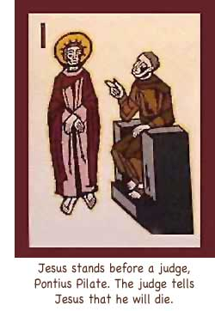
H
O
L
Y
W
E
E
K
Notes:
First Station
Jesus is standing before angry people who are yelling and saying mean, hurtful things to him. They scream at him. Some of them tell lies about him, saying that he did bad things.
But Jesus stays quiet, even though he knows that he will be hurt. He knows that God is with him. He even asks God to help him forgive the people who are yelling and telling lies about him.

Slide 4
T
H
I
S
W
E
E
K
Gossip
Lies
Notes:
Has anyone ever said mean or hurtful things about you, or has anyone ever told a lie about you? If someone did that to you, how did it make you feel?. Maybe you were scared, or hurt, or maybe you felt very angry.
When you are aware of how you felt, you know how Jesus felt. But Jesus didn’t retaliate, or try to get his accusers back – he simply told the truth.

Slide 5
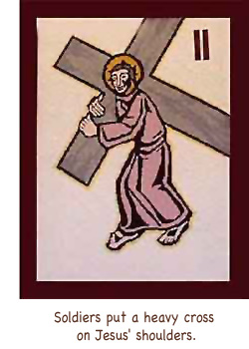
H
O
L
Y
W
E
E
K
Notes:
Second Station
When the soldiers put a big, heavy cross on Jesus' shoulders, Jesus doesn't fight with them or say angry words to them. He knows that he has to carry this cross a long way, and he knows that the way will be very hard for him at times. But Jesus knows that God is with him, and he asks God to help him to carry this cross, even though it is heavy.

Slide 6


T
H
I
S
W
E
E
K
Notes:
Have you ever had something happen that was very hard for you? A difficult job at home, complicated schoolwork or a problem in your personal life? Sometimes adults or older children might not treat you nicely. Sometimes we just can't have things the way we want them.
Take some time to examine how you feel when this happens – do we sulk… complain… or give out? How often do we simply get on with the task in hand like Jesus did?

Slide 7
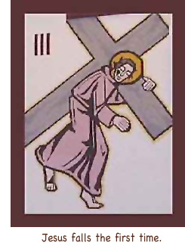
H
O
L
Y
W
E
E
K
Notes:
Third Station:
Jesus is so tired as he walks along the road with the heavy cross on his shoulders. The cross keeps pushing into his shoulder, and the stones on the road hurt his feet. People yell and push him; the soldiers shout for him to move faster.
Then Jesus falls, and the soldiers yell at him more. How tired Jesus is! Jesus prays in his heart, “God, help me remember that you are here.”

Slide 8
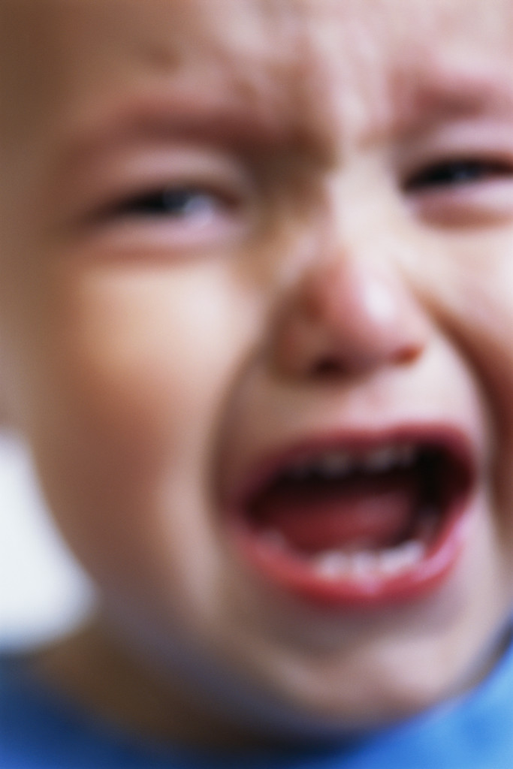
T
H
I
S
W
E
E
K
Notes:
Look at Your Heart
Did you ever fall when you were playing, or when you were helping with something? Falling really hurts, doesn't it? When people make mistakes or fail at a task, it is like falling. And when that happens, our hearts sometimes feels like it is hurt.
The mistake isnt what is important – what is important is that you get back up and try again.

Slide 9
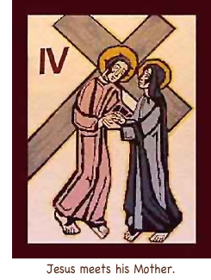
H
O
L
Y
W
E
E
K
Notes:
Fourth Station: Look at Jesus
As Jesus walks slowly with the cross on his shoulders, a woman comes up to him. It’s Jesus’ mother, Mary. How sad for them to see each other now. Mary feels so sad because she sees how much he is suffering, and Jesus sees the sadness Mary feels. Even though they both know that God is with them, they can’t even say anything to each other, because they are so sad.

Slide 10
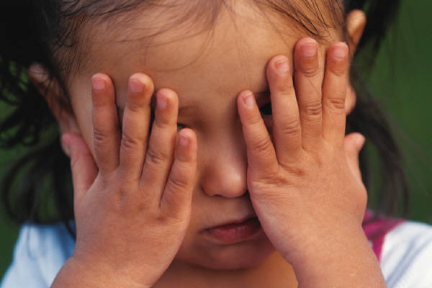
T
H
I
S
W
E
E
K
Notes:
Look at Your Heart
Have you ever been very sad, or do you know someone who has been very sad? Being sad can really hurt someone's heart a lot, can’ it? Sometimes our hearts are sad because we cannot be with someone we love. Jesus shows us that even at our saddest moment there are people there for us, who love us – our parents, our friends and God.

Slide 11
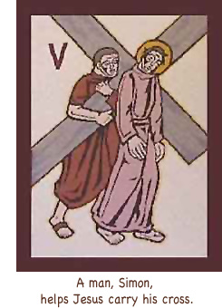
H
O
L
Y
W
E
E
K
Notes:
Fifth Station: Look at Jesus
Jesus is so tired that the soldiers know he cannot carry the heavy cross by himself. So they look around and see someone who looks strong enough to help Jesus carry this cross. This person's name is Simon.
Jesus just looks at Simon and quietly whispers, “Thank you” to Simon. Then they continue on the long road, carrying the cross together.

Slide 12
T
H
I
S
W
E
E
K
Notes:
Look at Your Heart
Sometimes helping someone can be difficult, for so many different reasons. Maybe you haven't finished something that you like to do, when someone asks you for help. Or maybe you just don't feel like helping that person. Jesus is the Son of God, and even He is not so proud that he refuses Simons help. But if you want help, you also must be willing to offer your help.

Slide 13
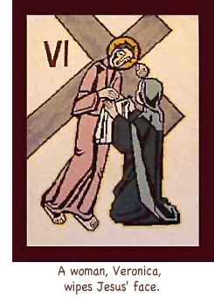
H
O
L
Y
W
E
E
K
Notes:
Sixth Station: Look at Jesus
Jesus is hot, tired, and sweating. His hair is all tangled, and he is covered in dust from the long walk.
Suddenly, a woman pushes her way out of the crowd and stands in front of Jesus. She takes a clean cloth and gently wipes Jesus’ face. Jesus is so thankful that he leaves a picture of his face on her cloth.

Slide 14


T
H
I
S
W
E
E
K
Notes:
Look at Your Heart
Have you ever helped someone? Have you ever done something that helped someone feel better? Sometimes you may have done something that you thought was very small or unimportant: bringing a glass of water or juice to someone, or even giving someone a helping hand with a job. Maybe you just smiled at someone who looked sad! The smallest thing we do for others can help them more than we will ever know!

Slide 15
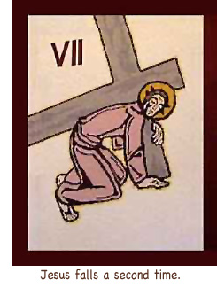
H
O
L
Y
W
E
E
K
Notes:
Seventh Station: Look at Jesus
How very tired, weak, and sad Jesus is now. Even though he keeps trying to walk with the heavy cross, he just can’t keep going. The noise from the crowd and from the soldiers makes him feel even worse. Then Jesus falls, because he just can’t take another step.

Slide 16
T
H
I
S
W
E
E
K
Notes:
Look at Your Heart
Most of us don’t complete a task perfectly the first time we try it. Sometimes even the things we know we can do can prove difficult sometimes. Do we give up? Do we simply not bother any more? Or, like Jesus, do we continue on and try our best to complete those things that are important.

Slide 17
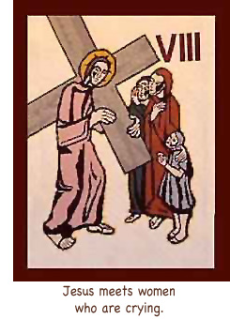
H
O
L
Y
W
E
E
K
Notes:
Eighth Station: Look at Jesus
After Jesus gets up, he continues on the road carrying his heavy cross. He passes some women who are crying because they are so sad to see Jesus suffer. But instead of thinking only of himself and how bad he feels, Jesus tells the women not to keep crying because of him. He tells them, instead, to take care of others, and especially to take care of their children.

Slide 18
T
H
I
S
W
E
E
K
Notes:
Look at Your Heart
Sometimes it is easy to just think about ourselves -- about what is not going the way we want it, or about problems that we have. It is very hard, then, to think about other people. But Jesus shows us how important it is to be more concerned about others. This doesn’t mean that we ignore how we feel, or what we need… but that we become more aware of how others feel, and others they need.

Slide 19
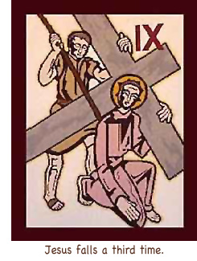
H
O
L
Y
W
E
E
K
Notes:
Ninth Station: Look at Jesus
Jesus is so tired now that he can hardly take another step. It is hard for him to breathe. He has been walking a long time along the dusty road, and he has no energy left. He just can’t go on anymore. Then Jesus falls down in the street for the third time. He is so very tired. Jesus asks God to help him. And Jesus gets up again, even though it is hard for him to do.

Slide 20
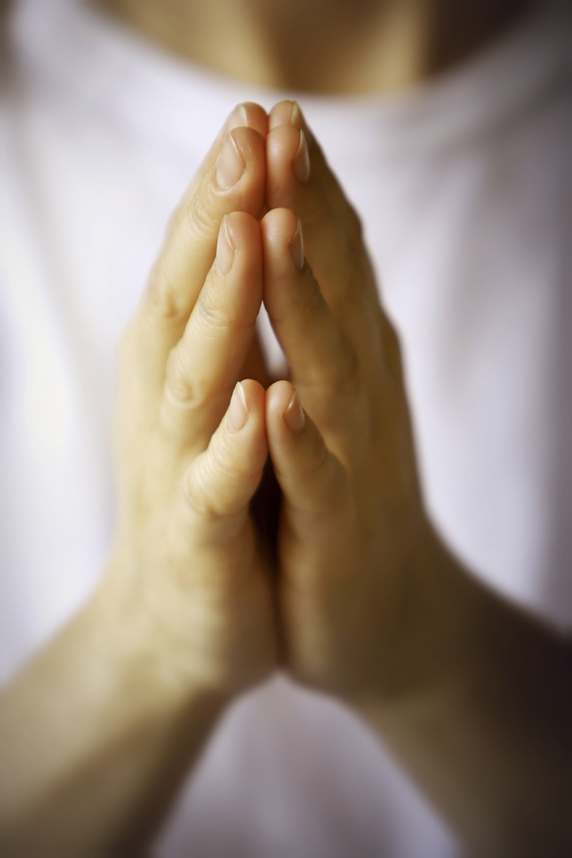
T
H
I
S
W
E
E
K
Notes:
Look at Your Heart
When we have really tried to do our best, and have not been able to succeed, it is easy to feel like Jesus did. Sometimes other people just keep yelling about something we do, or sometimes other people make fun of the way we do something.
At times like these, when we feel that there is no more hope or strength or energy left to carry on – we can pray to God for help.

Slide 21
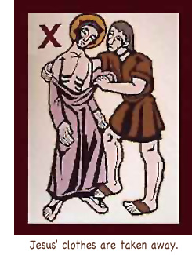
H
O
L
Y
W
E
E
K
Notes:
Tenth Station: Look at Jesus
Finally Jesus reaches the hill that is the end of the road he has to walk. Jesus knows that he will die here. But before he dies, the soldiers will do more to him. They pull off his long robe, and almost all his clothes are taken from him.
Jesus stands in front of the crowd with only a small piece of cloth covering part of his body. Jesus asks God to help him remember that he is not alone, that God is with him through all this.

Slide 22
T
H
I
S
W
E
E
K
GREED
&
Selfishness
Notes:
Look at Your Heart
Is it hard for you to share or to give away something that you like? Do you sometimes like to keep everything for yourself? Do you ever let a possession or a thing of yours be the reason for bad feelings or bad words between you and someone else? Jesus shows us that these things are not important – be sure to hold on to your dignity, self-respect instead of possessions.

Slide 23
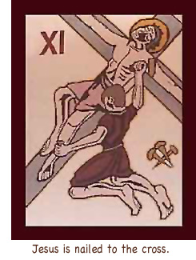
H
O
L
Y
W
E
E
K
Notes:
Eleventh Station: Look at Jesus
How much Jesus hurts as the soldiers nail him to the cross. He hurts all over; he is tired and thirsty; he knows that he is going to die. But he looks at the people who have hurt him and, instead of saying bad things to those people, Jesus asks God to forgive them. He looks at his mother and tells her to take care of others. Even when he is dying, Jesus is thinking of other people. Just before he dies, when he feels most alone, he calls out to his Father…

Slide 24
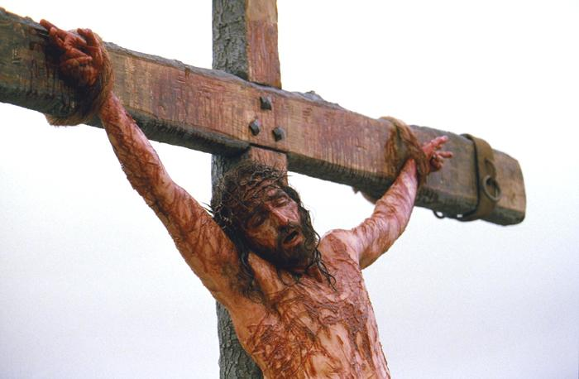
T
H
I
S
W
E
E
K
Notes:
Look at Your Heart
Right up until the moment of His death, Jesus continued to try His best and to do the right thing. Not always an easy thing to do – but Jesus went through this torment out of love for each one of us.
What excuse do we have for not trying our best for others?

Slide 25

T
H
I
S
W
E
E
K
Notes:
Look at Your Heart
Just before he died on the cross, Jesus did two things, both things show us that ‘God is Love’.
He forgave the thief who asked for forgiveness as he was crucified alongside Jesus. And he prayed to his Father.
It is at this moment, just before his death, that Jesus is at his most human and his most holy.
While he feels alone and desolate, very real human feelings, he still has faith and calls out to his Father.
It may seem like doubt or lack of faith, or even anger – but Jesus knows that the Father is there,,, that is why he calls to Him. And that is why he says ‘Father, into your hands I commend my spirit’ just before he dies.
The cross is not a sign of death – but because of what Jesus did, it is now a sign of love.

Slide 26
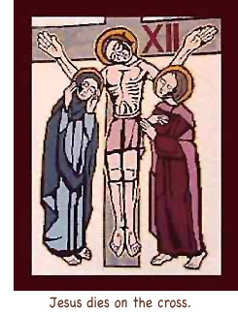
H
O
L
Y
W
E
E
K
Notes:
Twelfth Station: Look at Jesus
Finally, after the long walk, after falling three times, after having the men beat him, after being nailed to the cross and suffering on the cross, Jesus bows his head and dies.
Now this part of his life is over. There is nothing left for Jesus to give or to do. Jesus has given his life for all of us.

Slide 27
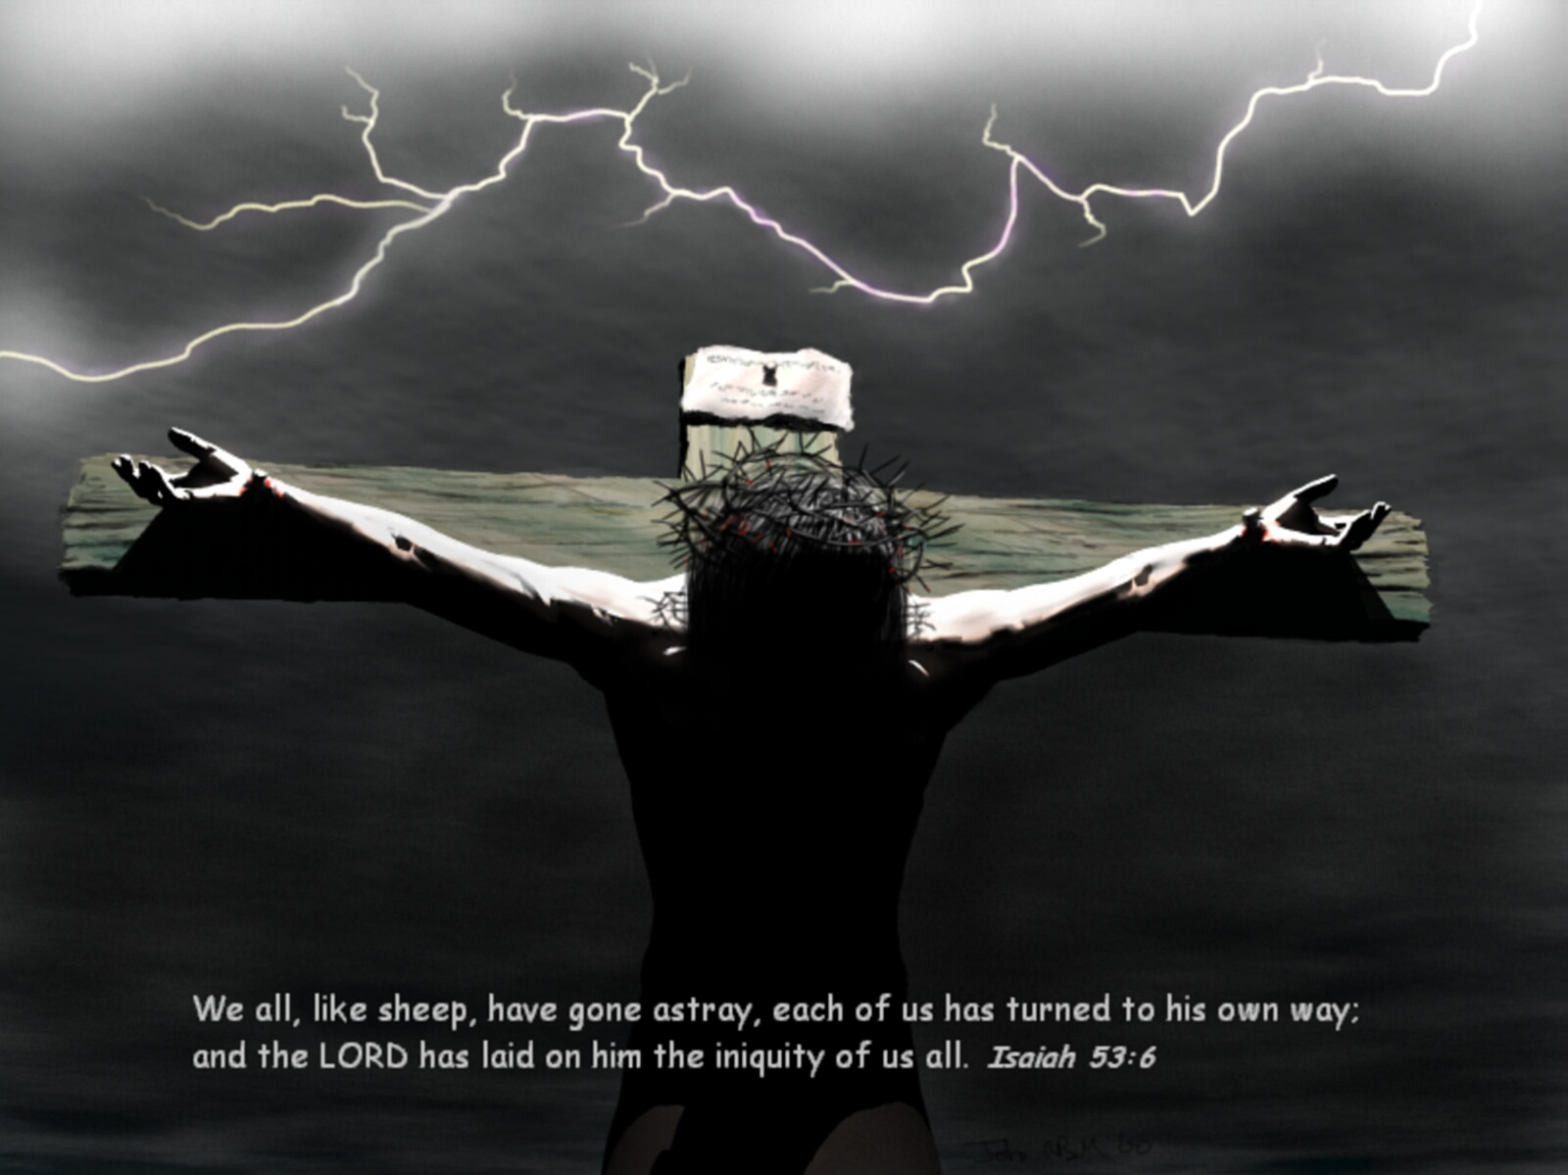
hhhhhhhhhhhhhhhhhhhhhhhhhhhhhhhhhhhhhhhhhhhhhhhhhhhhhhhhhhhhhhhhhhhhhhhhhhhhhhhhhhhhhhhhhhhhhhhhhhhhhhhhhhhhhhhhhhhhhhhhhhhhhhhhhhhhhhhhhhhhhhhhhhhhhhhhhhhhhhhhhhhhhhhhhhhhhhhhhhh

Slide 28
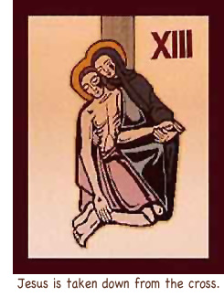
H
O
L
Y
W
E
E
K
Notes:
Thirteenth Station: Look at Jesus
Now Jesus’ lifeless body is taken down from the cross. No more pain or suffering for Jesus; all the pain is over. Mary, Jesus’ mother, holds him tenderly in her arms. How sad she is. And how sad Jesus’ friends are. They are crying as they hold his body.

Slide 29
T
H
I
S
W
E
E
K
Notes:
Have you ever had to say goodbye to a loved one forever…?
Have you moved house, moved country – or has a member of your family passed away through old age or ill health?
Saying goodbye is not always easy…

Slide 30
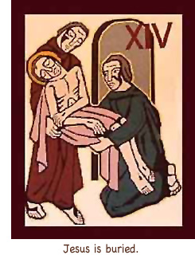
H
O
L
Y
W
E
E
K
Notes:
Fourteenth Station: Look at Jesus
Jesus’ friends wash his body and wrap it in a clean sheet. They touch his body gently, and then they put his body into a tomb. When they are finished, they push a very large stone over the entrance, so that no one can go inside.
Now there is darkness in the tomb where Jesus’ body lies, and all of his friends go home because they are very sad and tired.

Slide 31
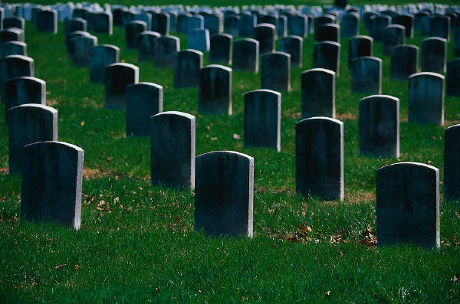
T
H
I
S
W
E
E
K
Notes:
Look at Your Heart
Is there someone you love who has died? When you remember that person, how does your heart look?
You can show your heart to Jesus, and show Jesus what you miss about the person who died. Jesus knows what your heart looks like, and loves you when you show him your heart. He can help ease our pain at the loss of loved ones when he shows us the true message of Easter.

Slide 32
Prayers of the Faithful
Response to the prayer is:
Lord, graciously hear us.

Slide 34
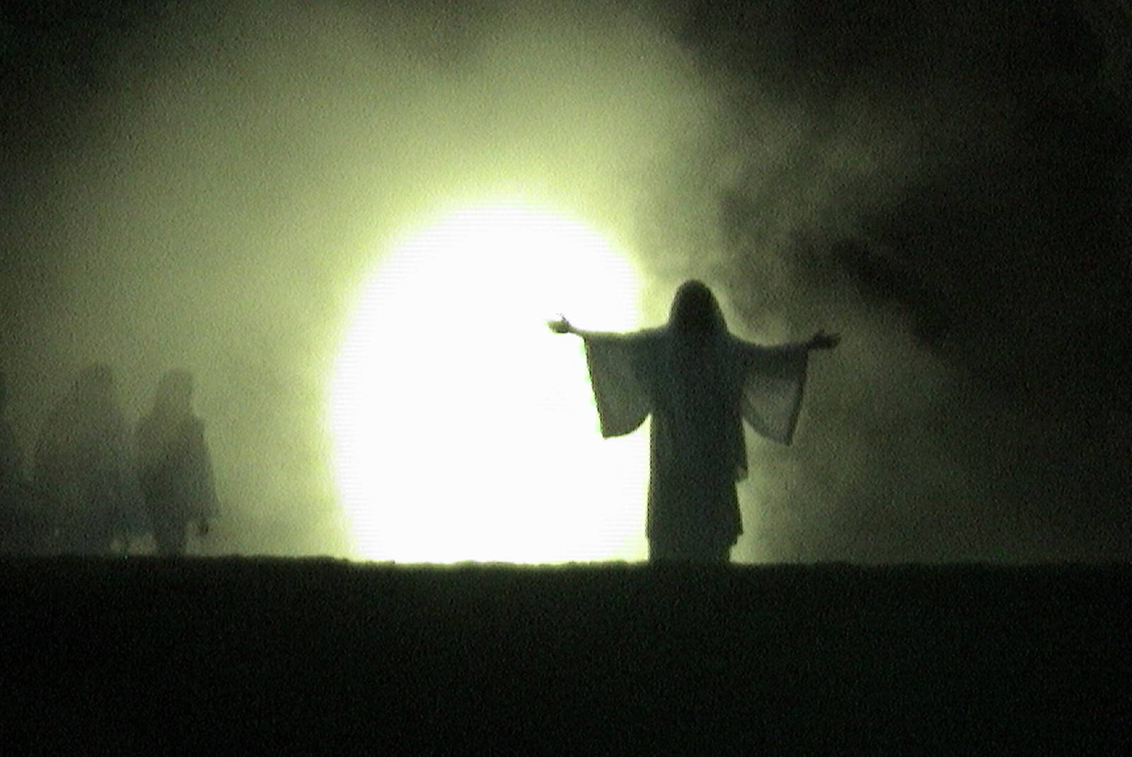
Alleluia! He Is Risen!
Notes:
"Jesus is risen from the dead. The centuries have not been able to bury him. Forsaken by his friends, sentenced to die with thieves, his mangled body buried in a borrowed tomb, he has risen to command the hearts of millions, and to rid our hate-filled world of the restlessness, possession-obsession and loneliness that is the result of today’s society’s lack of hope. Each New Year brings him increasingly to life. The forces that tried to destroy him along the Stations of the Cross have long ago destroyed themselves. Those who passed judgment upon him are remembered only because of him. Military might and political tyranny still stalk the earth; they too shall perish, while the majesty of the carpenter-prophet bearing his cross to the hill will remain to overwhelm the ways of violence with his simple and enduring message of love.“
Please stand for our final prayer…
Glory and praise to You, Risen Saviour, for You bring light to our darkness, joy to our sorrow, and the fullness of love to our reluctant hearts.
Once and for all You have conquered sin and evil. In the glory of Your Resurrection we have been set free from all that keeps us from following You.
In this Easter season, fill our hearts with Your Light and Grace that we might joyfully echo the words of Your Holy Angels:
He is not here in the tomb:
He is risen!
Alleluia! Alleluia!
In the name of the Father…
…Amen.

